Slide 1

Recharge 2025
Monetising the guest o tenant journey

Slide 2
The Session
Rather than looking solely at income streams from the space in assets, how can owners, developers and operators think about additional revenue streams from their end users, and what is the role of technology in enabling these new revenue streams?

Slide 3
Let’s start with…
Revenue Beyond the Room
The role of data and personalisation in driving growth – A Research Project.
Matthew Prosser
Paul Finch
Agilysys UK

Slide 4

The guest or tenant has changed
Personalization and recommendation has become normalized in Society.
Levels of personalization by the likes of Netflix, Amazon, Banks and others is expected from all services.

Slide 5
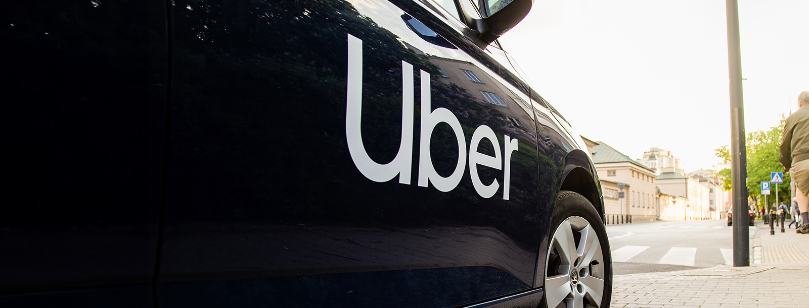
It was never about the cab
Before Uber, all cab companies ran their businesses based on occupancy, and average passenger fare.
Uber knew that it was never about the cab, it was about the ‘passenger’

Slide 6
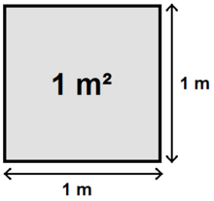

Is it space, or Guest? Personalisation holds the key
How data can unlock guest potential
Space
Guest
Constrained
Sell once
Sometimes commissioned
Price pressure downward
Inanimate and Unimaginative
Experiential
Spend more
Advocacy and loyalty
Pay for value
Human, stories, life

Slide 7

But. There is a problem
Registered in the reservation system
Do you really know your guests?
Registered in the restaurant system
Registered in the Spa system
Notes:
If you subscribe the the revenue potential of the guest then why isn’t Revenue Per Guest, or some similar metric, more used and talked about across our industry? I would suggest that the answer is that hospitality technology has been slow to catch up.
This slide is perhaps an over-simplification of a situation that many properties face and this is that the challenge of tracking revenue per guest is hindered by the ‘which guest’. The way that many solutions are architected means that a guest is registered, booked into and known by any number of booking systems across a property and to date, merging and making sense of these multiple guest profiles is not easy.
The architecture is attractive at first glance. Often called ‘best of breed’ it offers a property the scope to purchase or use whatever solution is currently operating, or is preferred, in any amenity of the property. For the restaurant, or the spa this is great, they can run their business efficiently with a system that staff know, and works well for them, but for the operations team the story changes. While all these systems can ‘talk to each other’ through a network of APIs (application programming interfaces) interoperability doesn’t deliver interchangeability. Yes, the systems talk to each other, but do they pass data in a way that unifies and normalises these data? Unless there is a data management team doing this work then the answer is probably no, and any analysis of individual guests will be done through spreadsheet analyses. Time consuming, complex with results that add little value to decision making while a guest is still on property.

Slide 8

The Holy Grail!

Slide 9

The future of hospitality
Reservations
Data . . . One guest, one guest profile
Restaurant
Spa / Golf …
Notes:
If multiple guest profiles is problematic, then the obvious answer is a single guest profile and more importantly a system architecture that enables this. The technology principles are pretty straightforward, if every amenity and service across a property is using the same booking engine than maintaining a single guest profile follows. Of course, the benefits of a single guest profile aren’t just of value to the property operations team, they are of significant value to the guests themselves and through the ability to book a complete itinerary in one transaction.
What you see here is a ‘simplified’ technology architecture and the challenge of simplification is that it is hard. Steve Jobs famously described how hard, simple is. Simple is a driving force of the Apple business and technology that we all know today and if simple is hard then it takes time, effort, resources, commitment and dedication.

Slide 10
The potential beyond revenue per guest
What data (AI) predicts about my guest
A unified guest profile. The key to unlocking the future of hospitality
What data tells me about my guest
Notes:
If we have technology that can deliver an operational single guest profile, like Uber we can start learning more about each guests' habits, preferences, choices and with this insight begin making decisions, often in real-time with the guest, that open new revenue potential so that measuring ‘Revenue Per Guest’ becomes the baseline, we can now look beyond at growth and how else we can monetise the guest to grow revenue beyond the room.
At Agilysys we have been conducting some pilot work to study this potential and look at how technology could begin to predict revenue opportunity per guest.

Slide 11
Project Background / Objectives
Data Discovery Initiative of “Guest-Centric” Revenue Optimization
Validate Concept of “Revenue per Guest”
Create a “Revenue per Guest Optimization Model” using Transactional Data at the Guest Level (n = 1,000 Guests)
Model then uses Propensity Scoring to Make Recommendations for Cross-Sell Offers and Experiences while Guest is On Property
Notes:
Working with a team of data scientists and 12 months of anonymised data of 1,000 guests of a USA multi-amenity property the team has examined patterns, behaviours and conducted propensity modelling on the cross-selling opportunities to guests while on property. The findings to date have been fascinating.

Slide 12
Summary Findings:
Total Purchases/Spend Over Time ($4.2M)
Total Additional Opportunity ($1.8M):
  Golf = $578K
  Spa = $1M
  Room = $159K
Projected (Propensity) Opportunity ($393K):
  Golf = $198K
  Spa = $162K
  Room = $33K
Projected Revenue Lift (9.3%):
  Golf = 7.7%
  Spa = 13.5%
  Room = 7.3%
 | Golf | Spa | Room | Total
Total Spend | $2,578,849.77 | $1,204,236.40 | $455,375.00 | $4,238,461.17
Total Opportunity | $577,705.87 | $1,019,280.00 | $158,625.00 | $1,755,610.87
Projected Opportunity | $197,544.74 | $162,427.63 | $33,150.45 | $393,122.82
Projected Revenue Lift | 7.7% | 13.5% | 7.3% | 9.3%
*Note: Based on n=1,000 guest data sample
Notes:
What you see here is real findings from the study to date. On the left is the view for the property which shows that the 1,000 guests modelled:
Spent a total of $4.2M in the 12-month period
That a total uplift opportunity of $1.8M was available in the 12-month period
Using propensity modelling (this is the likelihood of guests taking offers) then $393K of missed sales were left on the table over the 12-month period
Finally, the projected revenue uplift over the 12 months would have been 9.3%
On the right hand side, you can see the individual breakdown by amenity where the largest cross sell opportunity was with Spa services at 13.5% missed opportunity over 12 months.

Slide 13

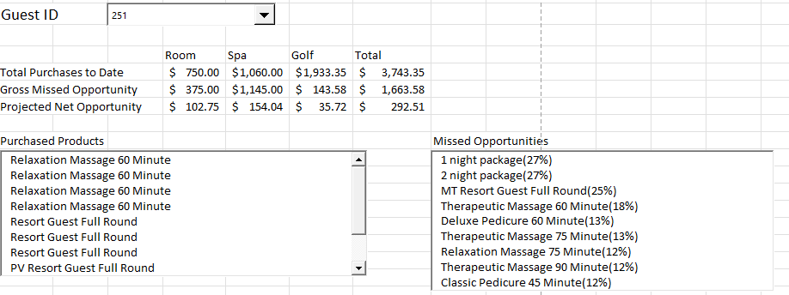
Revenue Per Guest Optimization Example
(Example)
GUEST ID: 251
Segment: Executive Traveler
Lifetime Total Spend: $3,743
Total # of Stays: 4
Avg Spend/Visit: $936
Revenue Opportunity:
Total Opportunity = $1,664
Projected Opportunity = $293
Top Products/Services:
  Room (Add’l Nights): 27%
  Golf (MT Resort): 25%
  Spa (Massage): 18%
Notes:
This slide shows the findings for just one guest, guest ID 251.
Guest 251 is an executive traveller who has made 4 stays at the property with a total spend of $3,743 (shown in the blue panel). The total cross sell opportunity for this guest was $1,664 with the propensity model showing a strong likelihood of $293 additional revenue from this guest at a next visit. The additional revenue opportunity is projected to come from three sources
Enhanced room package(s)
Golf round(s)
Spa massage services
The details, although small are shown in the left-hand window the services that this traveller has purchased before and in the right-hand window the services that could be offered with the likelihood of them being taken.

Slide 14
Summary
There is huge growth potential in the shift from “how can I sell my space” to “Where can my guest spend more”.
Guest data, personalisation and AI will drive this shift.
A unified or single guest profile is the key that will unlock the potential.
Today’s ‘best of breed’ systems model is limiting personalisation
Notes:
And so, in summary.
Revenue per Room (RevPAR) remains of value but isn’t reflective of the total revenue opportunity available from the guest.
The rise of OTAs only drives room rates down and commission rates up.
Revenue per Guest (RevPAG) opens up the potential of all available revenue streams in a more meaningful way but is technologically difficult without a single guest profile.
Based on the test modelling that Agilysys has been undertaking a property leaves almost 10% revenue uplift on the table and this could be much more in practice.

Slide 15
The workshop
Boutique Hotel
Student Accommodation Building
Serviced Apartment with Workspace
Apartment Block – Vacation Rentals
Co-Lliving building
Exercise 1 – 15 minutes groups discussion
Thinking like Uber. What additional revenue opportunities could be created from greater levels of guest personalisation and insight to their preferences?
Teams feedback
Exercise 2 – 15 minutes groups discussion
What technology, data or operational barriers are preventing you from monetising the guest journey in more ways?
Teams feedback

